Slide 1
Investigating the Impact of Gender on Rank in Resume Search Engines
Le Chen, Aniko Hannak, Ruijin Ma, and Christo Wilson
Northeastern University, Central European University, Rutgers University

Slide 2
Hiring Websites
Platforms for millions of job hunters and thousands of recruiters
Powerful resume search engines that help recruiters locate qualified candidates

Slide 3
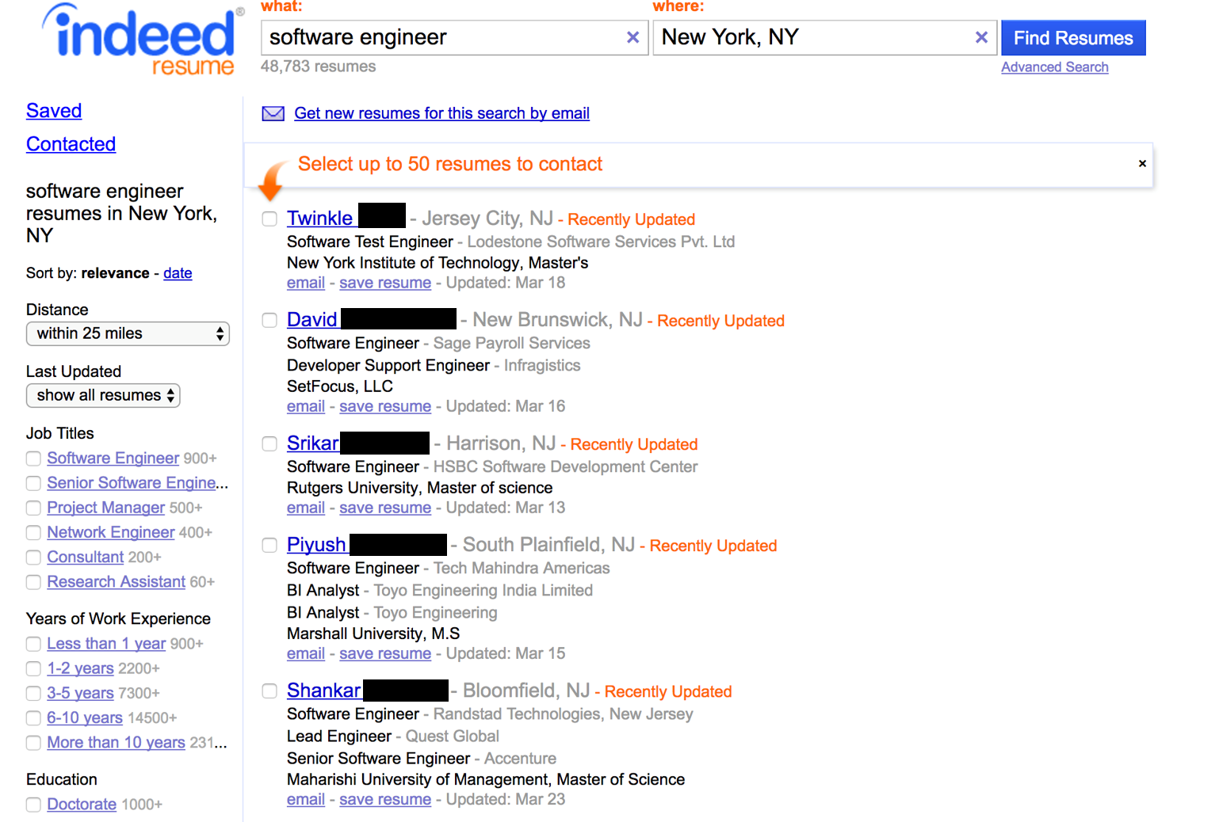
Demographic information and profile images are explicitly not collected

Slide 4
Hiring Discrimination
Human cognitive biases impact decision making processes
(Unconscious) racism and sexism impact employment opportunities
Online recruitment: demographic information is not collected
Similar to orchestra blind auditions

Slide 5
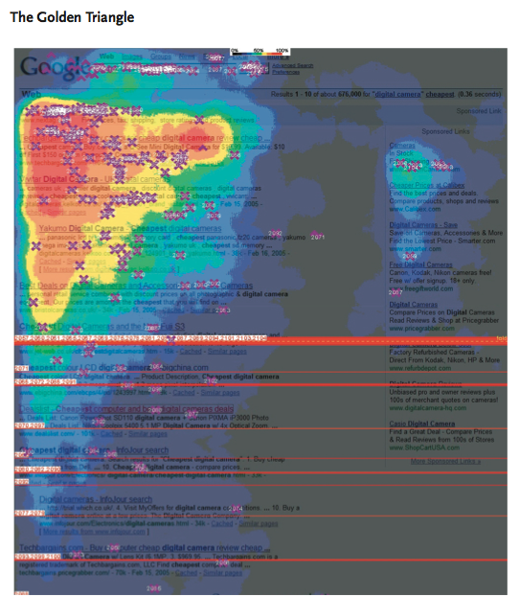
Hiring Discrimination
(Unconscious) racism and sexism impact employment opportunities
In theory, hiring discrimination should be minimized by the resume search engine
No demographics
No profile images
However, ranking algorithm may encourage discrimination
Features that correlate with demographics may affect the ranking
See Hannak et al., CSCW 2017

Slide 6
Goals
Investigate gender-based inequalities in the ranking algorithms of major hiring websites
Two definitions of fairness
Individual fairness – equal opportunity
Group fairness – disparate impact
If gender has an effect on rank, is there direct discrimination?
Does the ranking algorithm intentionally use gender as a feature?
It is easy to infer gender from names

Slide 7
Outline
Motivation
Data Collection
Measuring Individual and Group Fairness
Measuring Direct Discrimination
Conclusion

Slide 8
Experimental Subjects
Some of the most popular employment sites in the US
LinkedIn is the largest but is too expensive ($9000) and litigious
On Monster and CareerBuilder, candidate data is not public
Purchased recruiter accounts to access candidates
Data needs: many, many search results
Queries need to cover diverse populations and professions

Slide 9
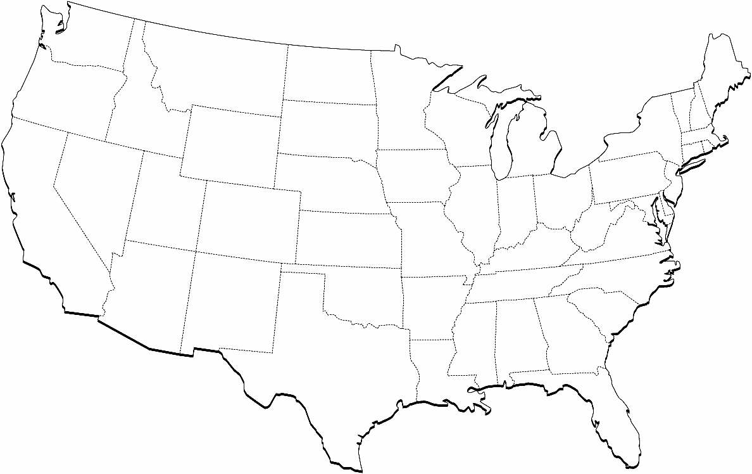
Query Diversity
35 job titles
High-skill jobs
Software/network/electrical engineers
Physical therapist, registered nurse
Accountant, financial analyst, auditor
Low-skill jobs
Laborer, mail carrier, concierge, truck/taxi drivers
Customer service and support, call center director
20 cities

Slide 10
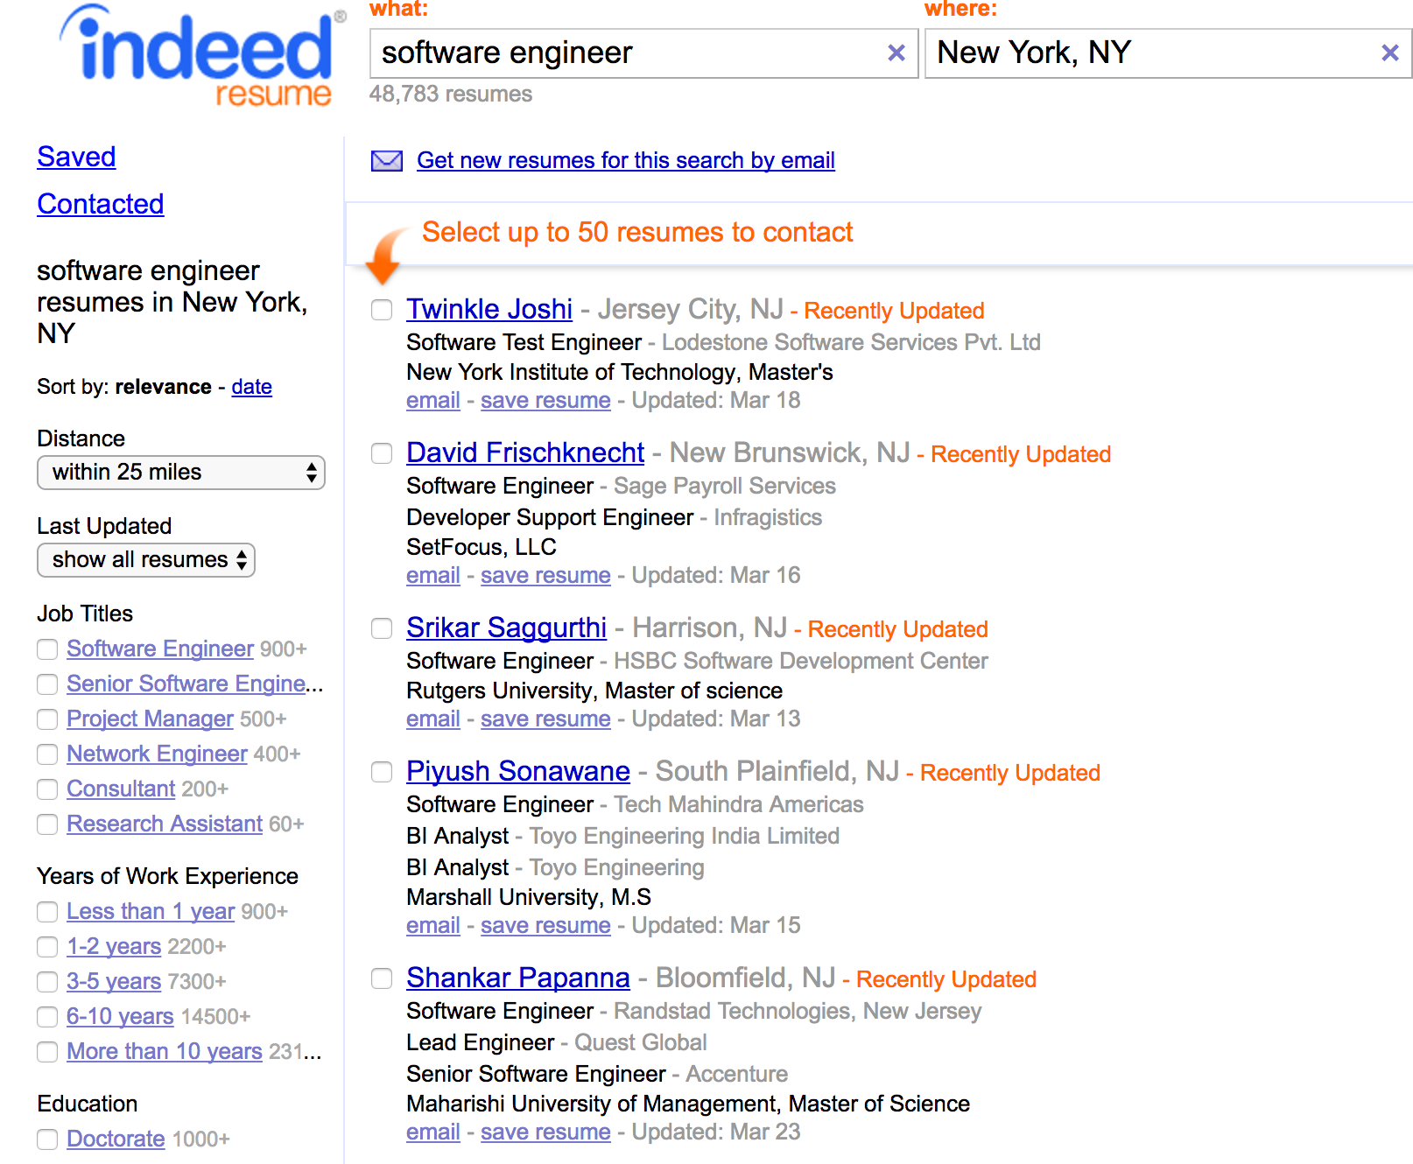
Candidate Features
Profile information
Job title and skills
Experience and education
Resume modification date
Resume information (Indeed only)
Personal biography, etc.
Features
Indeed – 13
Monster – 13
CareerBuilder – 6
What about gender?

Slide 11
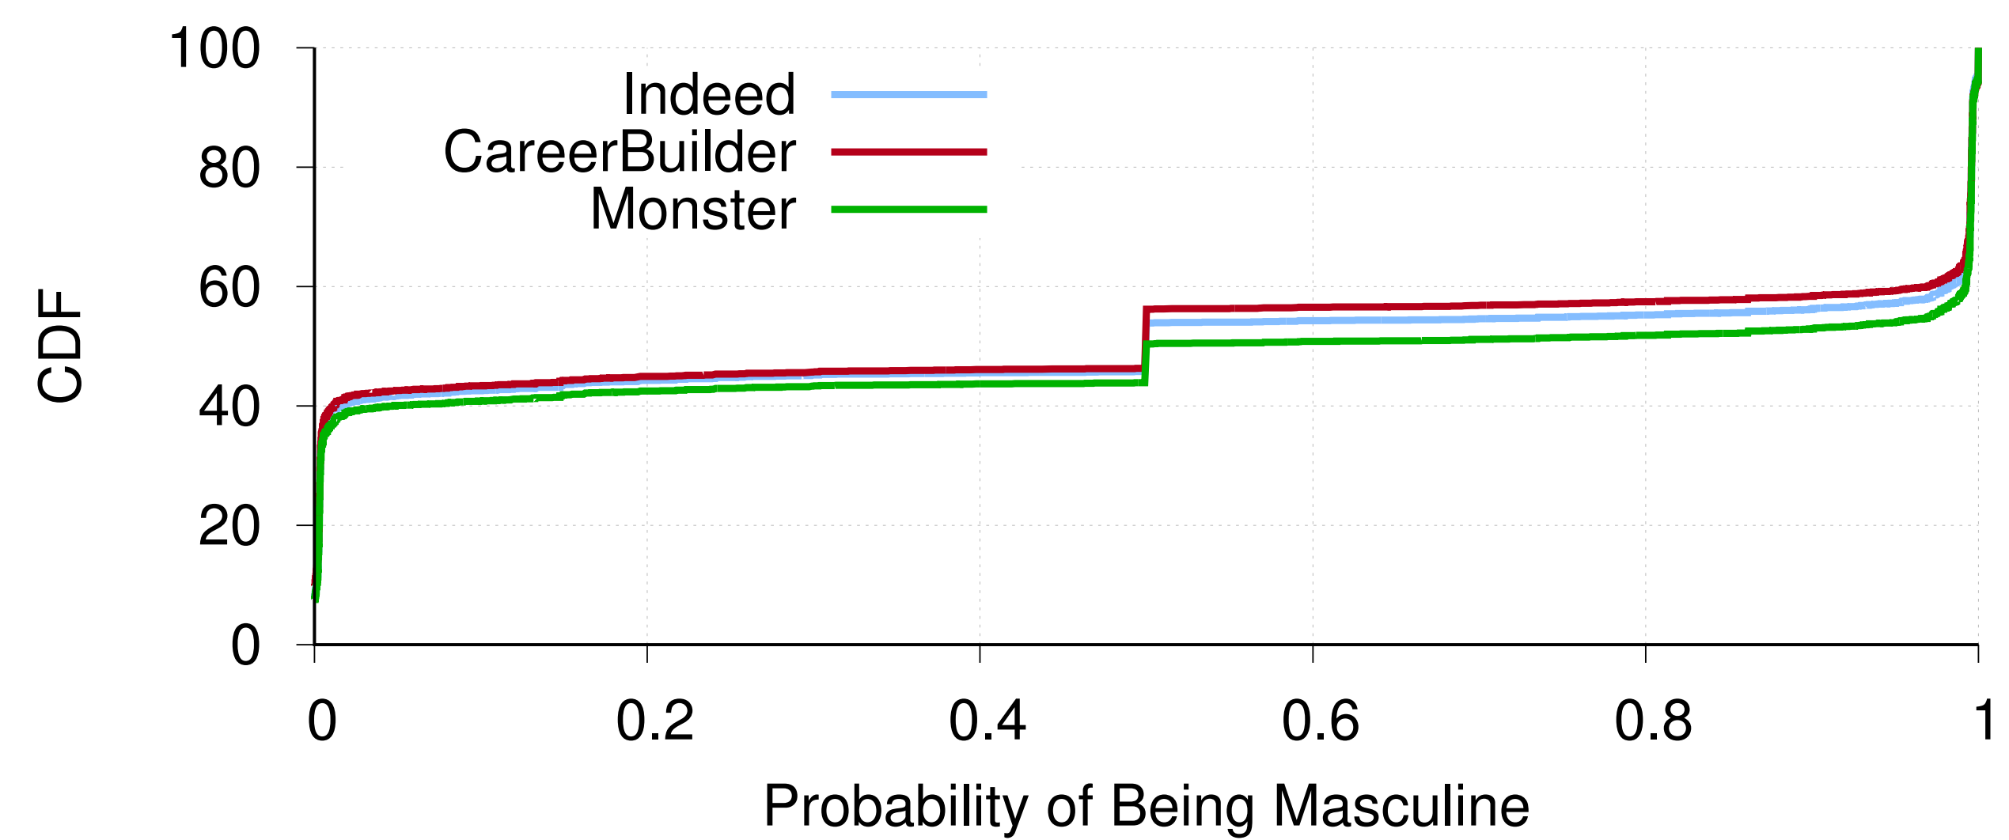
Inferring Masculinity
Use the US baby-name dataset to infer masculinity based on first name
First names not included in the baby name dataset
8% of the population have 0.2 < p(masculine) < 0.8

Slide 12
Data Summary
Queries for 35 job titles in 20 US cites
Top 1000 candidates per job per city
Collected between May and October 2016
Total Unique Candidates
Indeed | 512,000
Monster | 265,000
CareerBuilder | 68,000

Slide 13
Outline
Motivation
Data Collection
Measuring Individual and Group Fairness
Measuring Direct Discrimination
Conclusion

Slide 14
Research Questions
Are the search engines individually fair with respect to gender?
Definition: placing candidates with similar features, excluding gender, at similar ranks
Equal opportunity
Are the search engines group fair with respect to gender?
Definition: assigning similar distributions of ranks to men and women
Disparate impact
If unfairness is present, is there direct discrimination?
Does the ranking algorithm intentionally use gender as a feature?

Slide 15
Measuring Individual Fairness
Candidates with similar features should have similar rank
Excluding gender
Controlled comparison → regression
Dependent variable: log(rank)
Accounts for decay in attention as rank decreases
Standard discounting function in the IR literature
Mixed Linear Regression model
log(rank) = feature_values * feature_weights + random_effect + error_terms
feature_weights: same for every job title and location (single algorithm)
random_effect: different intercepts for different <job title, city> pairs

Slide 16
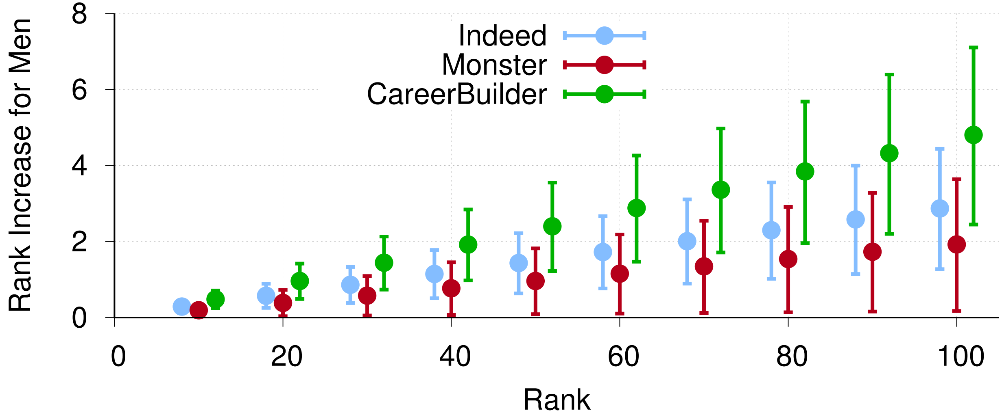
Analyzing Gender Effects
Starting around round 50, ties are consistently broken in favor of men
Negative effect of p(masculine) on log(rank)
Being male confers a bonus
All three sites exhibit unfairness
Practical impact of p(masculine) is negligible

Slide 17
Measuring Group Fairness
Assigning similar distributions of ranks to men and women
Mann-Whitney U → are the rank distributions of men and women significantly different?
Service | Job Titles w/ Significant Unfairness (p<0.05) | Favoring? | Examples
Indeed | 13.2% | Men | Corrections Officer, Customer Service, Electrical Engineer, Mail Carrier, Mechanical Engineer, Network Engineer, Software Engineer, Truck Driver
Monster | 8.5% | Men
CareerBuilder | 13.2% | Men

Slide 18
Measuring Direct Discrimination
Gender not considered, no direct discrimination
Original Search Results
After Modification
Recall: these hiring websites do not collect demographic information
How can they possibly be unfair against females?
Hidden features that are proxies (correlate) with gender
Resumes contain much more information about candidates
Controlled experiments on eight resume features
Feature | Indeed | Monster | CB
Inferred Gender | X | X | X
School Ranking | X | ✓ | X
Currently Employed? | X | ✓ | ✓
# of Keywords | X | X | X
Resume Length | X | X | X
Job Churn | X | X | ✓
Contact Information | X | X | X
Company Name | X | X | X
1
1
2
2
…
…
Joe
Joe
Bob
Amy
…
…
n-1
n-1
n
n

Slide 19
Outline
Motivation
Data Collection
Measuring Individual and Group Fairness
Measuring Direct Discrimination
Conclusion

Slide 20
Limitations
Inferred gender $≠$ gender
Also, binary gender classification
Ecological validity
Models use assumptions derived from web search engines
How do recruiters actually interact with resume search engines?
Unknown why there a small amount of unfairness against women
Possibly a hidden feature that correlates with gender
Controlled experiments are not comprehensive

Slide 21
Conclusions
Individual fairness
Significant (p<0.05) negative correlations between gender and rank
Robust under a variety of conditions
Effect size is small, only by rank 30—50 is there practical impact
Group fairness
8.5—13.2% of job title/city pairs show significant (p<0.05) group unfairness
Unfairness always benefited men
Clustered in engineering jobs
No direct discrimination

Slide 22
Ethics
IRB approved
Limited impact of our crawler in the hiring sites
One request every 30 seconds
We will not be releasing the data
Contextual privacy
We did not contact candidates or recruiters

Slide 23
Model Fitness

Slide 24
Mixed linear regression on top 100 candidates
*p < 0.05, **p<0.01, ***p<0.001
Most of the features have negative and significant effect on log(rank)
Negative effect → higher rank
Negative effect of p(masculine) on log(rank)
Being male confers a bonus
All three sites exhibit unfairness
Results are robust
Top 1000 candidates
Propensity-matched candidates
With one, two, or three search filters
Feature | Indeed | Monster | CB
Fixed Effects | 4.803*** | 5.938*** | 4.129***
Job Title | -0.518*** | -1.3*** | -1.258***
Skill Relevance | -0.051 | -0.31***
Education | 0.042** | -0.061* | -0.027
Job Popularity | -0.115*** | -0.004 | -0.147***
Last Modified | -2.053*** | -0.197*** | -0.149***
Experience | 0.116*** | -1.303*** | -0.185***
Skill Popularity |  | -0.048**
Bio Relevance | 0.041
Info Relevance | -0.255***
Skills Match | -0.072
Info Match | -0.093*
Bio Match | -0.262***
p(masculine) | -0.042*** | -0.028* | -0.071***
Observations | 67410 | 50813 | 28289

Slide 25
Impact of Search Result List Length
Top k Candidates | Indeed p(masculine) | Monster p(masculine) | CB p(masculine)
10 | -0.023 | -0.031 | 0.027
20 | -0.009 | -0.056* | -0.023
50 | -0.036* | -0.047** | -0.053*
100 | -0.042*** | -0.028* | -0.071***
200 | -0.029** | -0.026** | -0.071***
500 | -0.022*** | -0.040*** | -0.055***
1000 | -0.019*** | -0.043*** | -0.039**

Slide 26
Example Recall Plot
“Software Engineer”

