Slide 1
Location, Location, Location: The Impact of Geolocation on Personalization
Chloe Kliman-Silver Aniko Hannak David Lazer
Christo Wilson Alan Mislove

Slide 2
Personalization
Search engines are our primary gateway to information
Google receives 48k queries every second
Use Personalization algorithms to find relevant content
More and more worries about the “Filter Bubble”
Is some content hidden from us?
Politics and news are particularly concerning
Pre-existing beliefs constantly reinforced
Notes:
Search engines have become the primary gateway to information in the developed world, we search for everything, all the time. For example, Google as the most visited website gets 48,000 queries every second.
To cope with the large amounts of content on the web, search engines are using personalization algorithms which help them find the most relevant content to show to their users.
These personalized results that we get are often very useful, for example if two people at the opposite ends of the world search for coffee shops they shouldn’t see the same results.
But in recent years, there has been an increasing amount of worry about the so called filter bubble effect, which might prevent people from seeing certain information because an algorithm decides it would not be relevant for them.
This is, of course, especially concerning in the area of news and politics. Users, by reading certain content or clicking on links, would reinforce an algorithm about their views, resulting in their getting trapped in an echo-chamber.

Slide 3
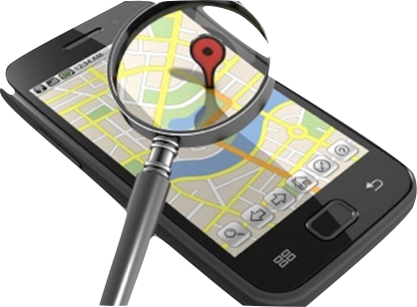
Location
Location found to be the primary influencing factor in Search personalization [Hannak WWW’13]
Location correlates with other sensitive user attributes
Income, Ethnicity, Political views, etc
Precise location tracking
through GPS of mobile phones
Notes:
Previous studies about personalization in Google Search have found location to be one of the most prominent features.
Location is a dangerous feature since it correlates with a lot of hidden variables, like demographic features, political views and so on.
This might lead to people getting different results, especially for certain queries. For example, vaccination is a very controversial issue in the US. More liberal states (mainly the coasts and parts of the midwest) believe that vaccinations are safe, whereas more conservative states (such as those in the south) believe it is dangerous and can cause autism. If personalization was happening, hypothetically, people in a liberal state might see pro vaccination results, whereas people in a conservative state might see results warning against it and see articles relating it to autism and so on.
This of course is shaping how people think about these issues, especially because most people still aren’t aware of personalization and treat Google’s results as some “objective truth”.
Course – comparing locations that were far away, and using IP address (precise) – what happens if we use closer locations (does personalization still happen) and what if we use more precise location
The above mentioned studies all used IP addresses to proxy location but of course the reality is different since mobile phones are able to track our precise location at all times. And websites actually have access to your precise location through the GPS coordinates provided by the phone.
The problem is, even us researchers who are more aware of these practices, have no way to know if and how precise location is taken into account when providing us content. So this is the question we are trying to answer in this study.

Slide 4
Contributions
I. Methodology to measure personalization due to precise location
II. Deploy it at scale to answer our questions:
At what distance do users begin to see changes in search results due to location?
Are certain types of queries more personalized?
Notes:
In this work we created a methodology that allows us to measure personalization due to location on a very fine grained level by emulating google search from any given location.
We will explore location based personalization along two main questions:
Q1: At what distance do users begin to see changes in search results due to location?
If I walk 200 meters, will i be directed to another restaurant? If i’m in another city, do i suddenly see different news results?
Q2: Are certain types of queries more personalized based on location than others?
Would a the name of an important politician be personalized differently than general information like childhood vaccines

Slide 5
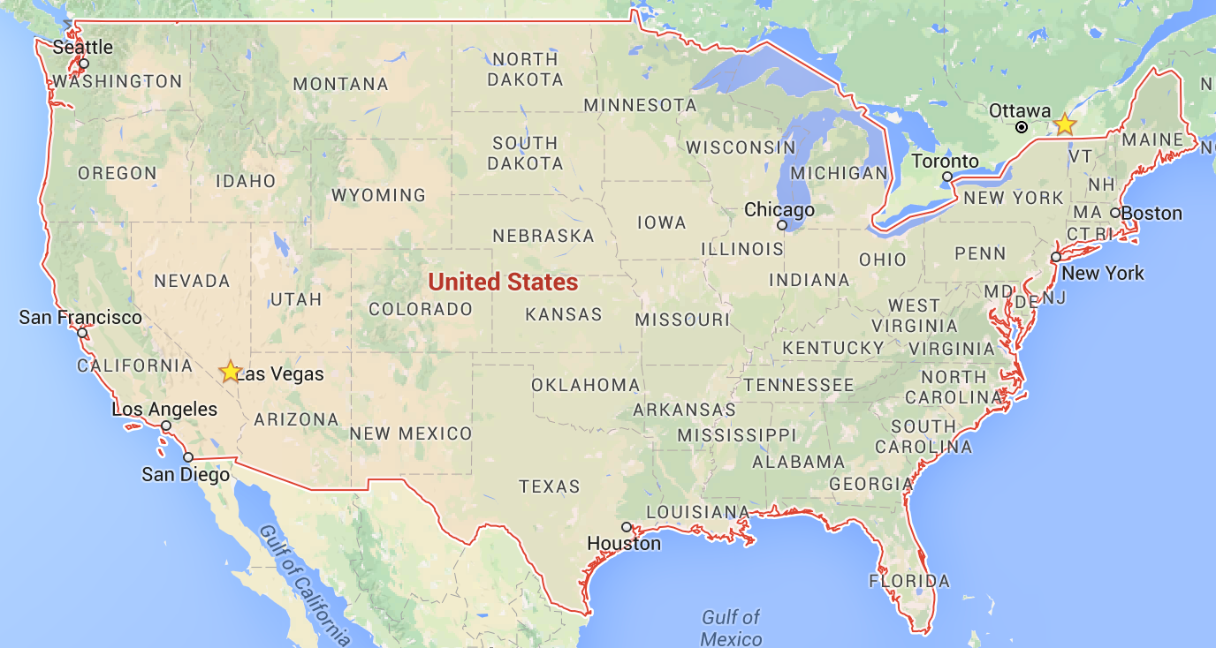
Experimental setup
Goal: Ability to send queries from anywhere
Mobile version of Google Search API asks for GPS
Two identical queries from each location
Queries in lockstep
74.125.225.67
Fixed IP to Google
Notes:
The basic idea for the experiment is very simple, we need the ability to send queries from different locations to Google at the same time and compare the results.
The way that precise location is implemented today is that a website can ask the mobile phone, what are your current GPS coordinates. So we extended PhantomJS, a headless browser to first pretend we send the query from a mobile phone and then reply appropriately, in this case with fake GPS coordinates.
There’s are couple of things we need to control for in this experiment to make sure the differences we observe are definitely due to location.
We have to make sure to send all queries at the exact same time from all locations since the ranking might change over time.
We also fix the IP address to Google, so that all locations are directed to the same data center.
Finally, we send two identical queries from each location. This is important because even for identical queries from the same location there might be differences due to other factors that we couldn’t control, for example internal load balancing or A/B testing. So when repeating this over many queries over many days, we can compare the identical queries and see on aggregate how much noise is there in the system.

Slide 6
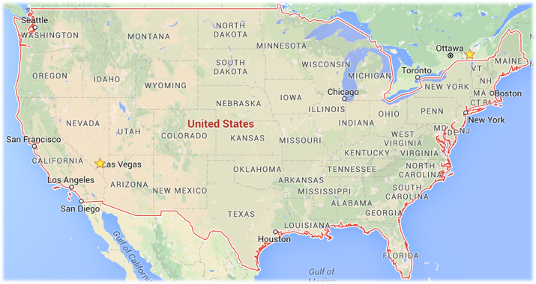
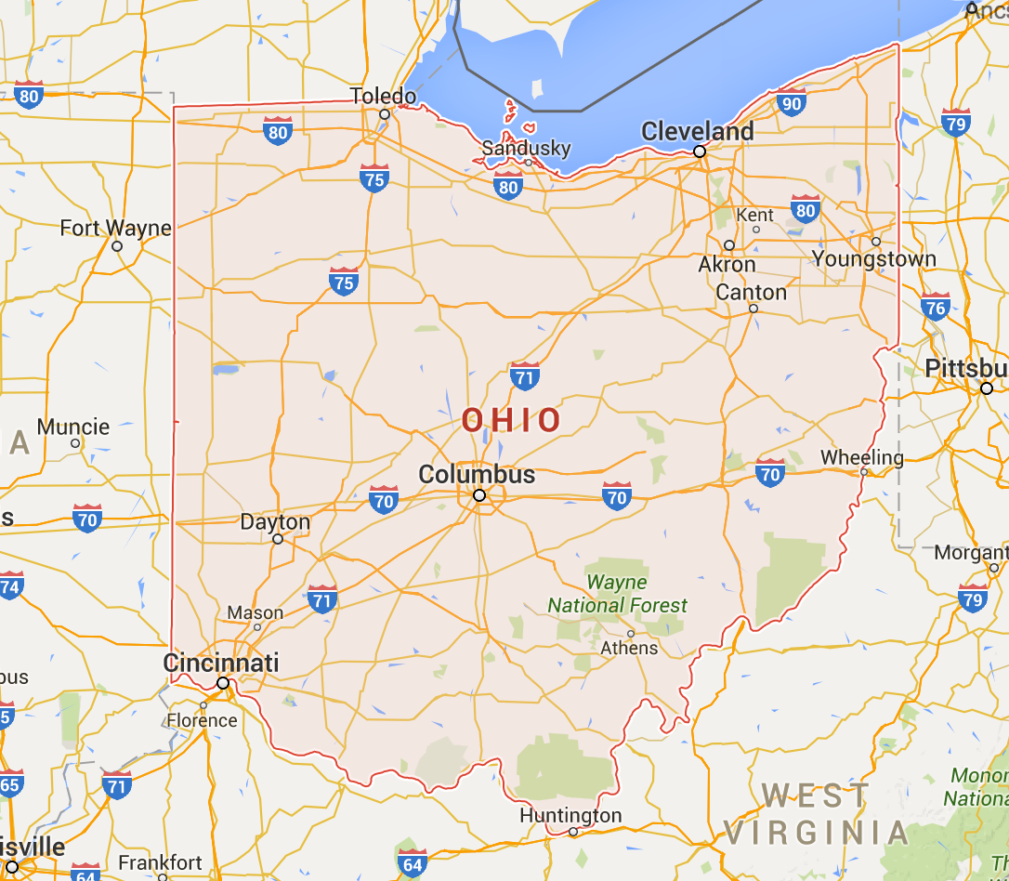
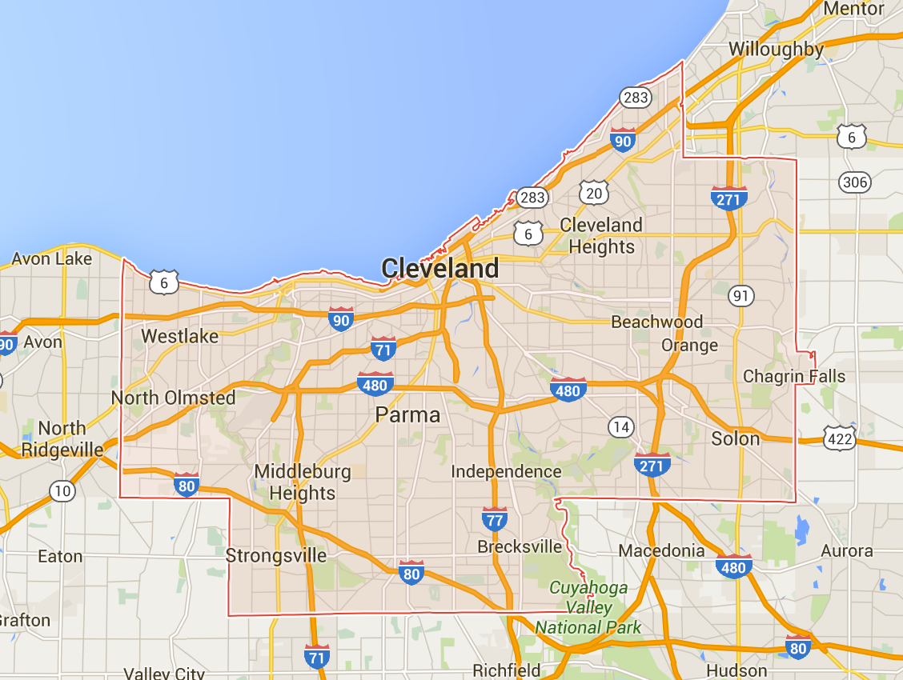
Picking locations
22 states
At what distance does location cause differences?
Introducing 3 different granularities
State-Level (Ohio)
County-Level
Nation-Level
Notes:
So going back to our first question, we want to know At what distance do users begin to see changes in search results due to location?
Beyond simply comparing results from different places we want to pick these locations according to different granularities to see at what granularity personalization happens, if at all.
So first we pick some locations on a national level, this means 22 randomly picked states in the US. For locations a little closer to each other we randomly pick 22 counties in Ohio, and finally the third granularity is country level, these are all voting districts within the biggest county in Ohio (average distance between two voting districts is mile apart).
We picked Ohio as the state to focus on as it is very polarized; some counties are very liberal, whereas others are very conservative, so it was perfect for looking at the granularity of personalization.

Slide 7
Search terms
Do some types of queries exhibit more personalization?
Local queries correspond to physical establishment (33)
“Post Office”, “Sushi”, “Starbucks”
News related, controversial queries (87)
“Late term abortion”, “fluoridate water”
Politicians corresponding with our locations in Ohio (120)
National figures, Ohio Senate, Cuyahoga County Board
Notes:
Our second question was if certain types of queries might be more personalized based on location than others
The intuition here is that some queries might result in the same result no matter where you search from but some others would change even if you walk a few hundred meters. Like Starbucks.
So our first search term category is what we refer to as Local queries. These are words that correspond to physical establishments, like ..
The second category is news related expressions that are often debated in the media. We picked these to be controversial topics such as these and global warming. I will refer to them as controversial search terms throughout the talk.
Finally we picked the names of 120 Politicians. These politicians correspond to the locations that we send the queries from, we have some national figures as well as the Ohio senate members and the county board in the county where we picked the voting districts from.

Slide 8
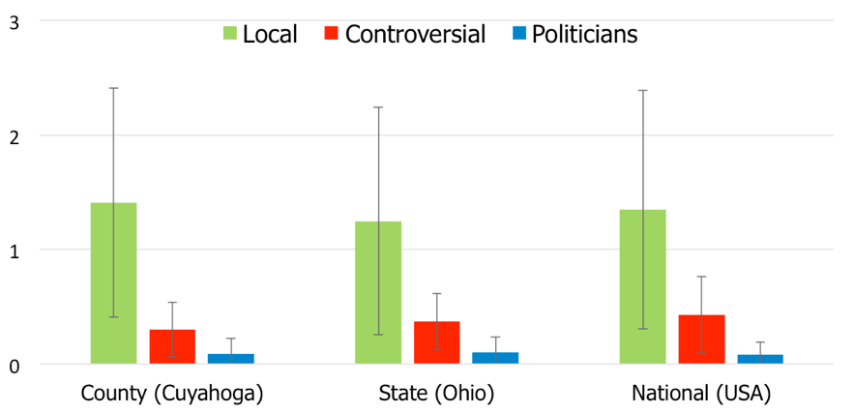
What is the level of noise?
Comparing identical pairs of queries
Edit distance
Notes:
Okay, so now we can finally get to the results. Let’s start with noise. Recall that at each location we had two identical queries. We were surprised by the level of noise for some queries.
The two queries return two pages with results which we will treat as two ordered lists and when determining the difference between them we use Edit distance. Edit distance is a number from zero to N and basically expresses how many results we have to swap on one page to get to the other page.
So, the y axis shows the average edit distance between all identical pairs.
On the x axis we have groups of granularities and we broke the results down by the query types.
The takeaway is that local queries exhibit a significant amount of noise, on average 1.5 results are moved around between two pages. Politicians are the least noisy out of the 3 categories. Completely identical queries, should be the same!!
To figure out what specifically on the page is causing these inconsistencies we looked at the differences by results type and found that about half of the noise comes from the embedded MAPs results, the other half comes from normal results.

Slide 9
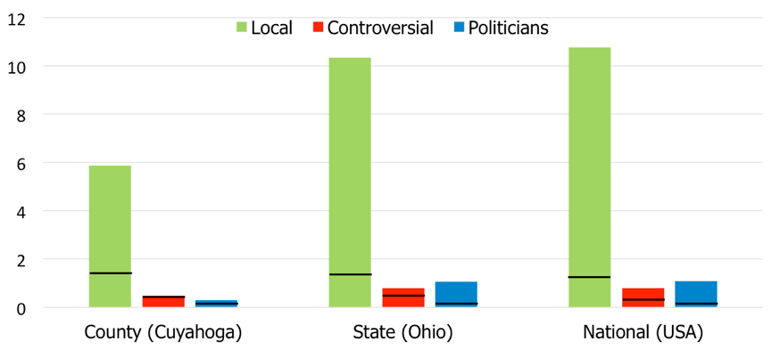
How much personalization?
Personalization across different types of queries and granularities
Personalization
Edit distance
Noise
Notes:
So now that we know the level of underlying noise we can move on to examining personalization levels by looking at queries that are not identical: they have the same term, but different location.
This plot is similar to the first one, average Edit distance on the y axis, results broken down by query categories and granularities.
So each bar is the average of all possible pairs within one granularity compared with each other. We also mark the noise levels, since only what we observe above that can safely be attributed to locations.
1, local terms exhibit most personalization, on average 6-10 result swap between 2 pages.
2, for news and politicians the values might not seem very high but important to note they are consistently larger than the baseline noise, especially for politicians so this means there is still personalization happening
3, And finally there is a trend for more personalization at larger distances, there is an especially clear cut between county level and state level distances.
Next we asked ourselves the question what happens if instead of averages we look at locations separately. Is there one location that for some reason behaves very different then the rest?

Slide 10
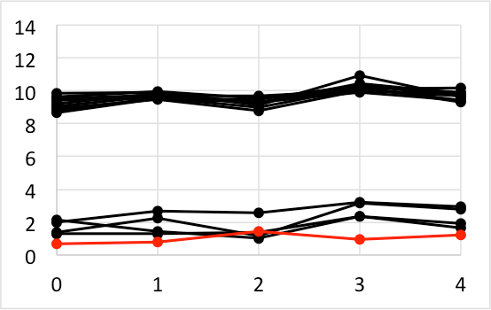
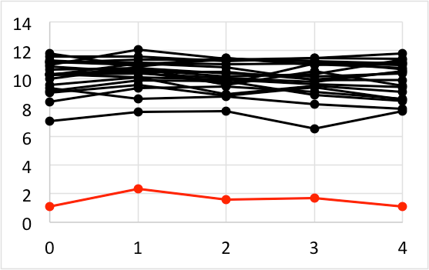
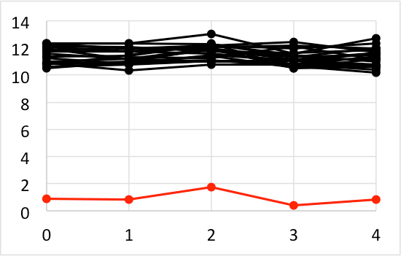
Impact of Distance
All locations compared to one baseline location
Baseline vs baseline
Baseline vs other locations
County (Cuyahoga)
State (Ohio)
National
Edit distance
Days
Days
Days
Consistency over time
More personalization with larger distances
Notes:
Thus, we examine each location separately.
At every granularity we randomly pick one location that we will call the baseline location. And then we take all other locations and compare it to that location.
So starting with our county results, we pick one baseline location and each line will represent the comparison with that location. The red line compares two treatments at the baseline location which will give us the noise level. The x axis here show consecutive days on which we ran the experiment, this way we also see that the results are consistent over time. We repeat this for state-level and national level queries.
As you can see generally the baseline noise clearly separates from the rest of the locations, and most of the locations are equally personalized. Additionally, as distances grow between locations, personalization levels get higher.
What this has shown is the granularity of personalization, even within a single county there are differences.
Even within a single county there is precise location.

Slide 11
Recap
Methodology to query Google search from any location
Analysis on 3600 queries from 59 different locations
Location has a large impact on the results:
Difference increases with physical distance
Local types of results are most personalized
Google returns very noisy results
Notes:
In this we first developed a novel methodology that allows us to query Google Search from any location around the world. Using this technique we sent 3,600 distinct queries to Google Search over a span of 30 days from 59 locations across the US.
Our findings show that location does indeed have a large impact on search results, and that the differences increase as physical distance grows. I didn’t have time to talk about all of our analysis in this talk but in the paper we also looked at specifics of search result types and how our search terms behave in more detail.
I started this talk expressing worries about the filter bubble. We currently don’t see much evidence that that’s taking place. But as these sites get more personalized, this might change and we’re hoping to use our methodology to see if this changes in the future.

Slide 12
Questions?
personalization.ccs.neu.edu
Notes:
See our website for more of our personalization work, data and code.

